Slide 1
Analysis on the Sample – Superstore(2014-2017) BY Ezeanyaso Ifeoma Love

Slide 2
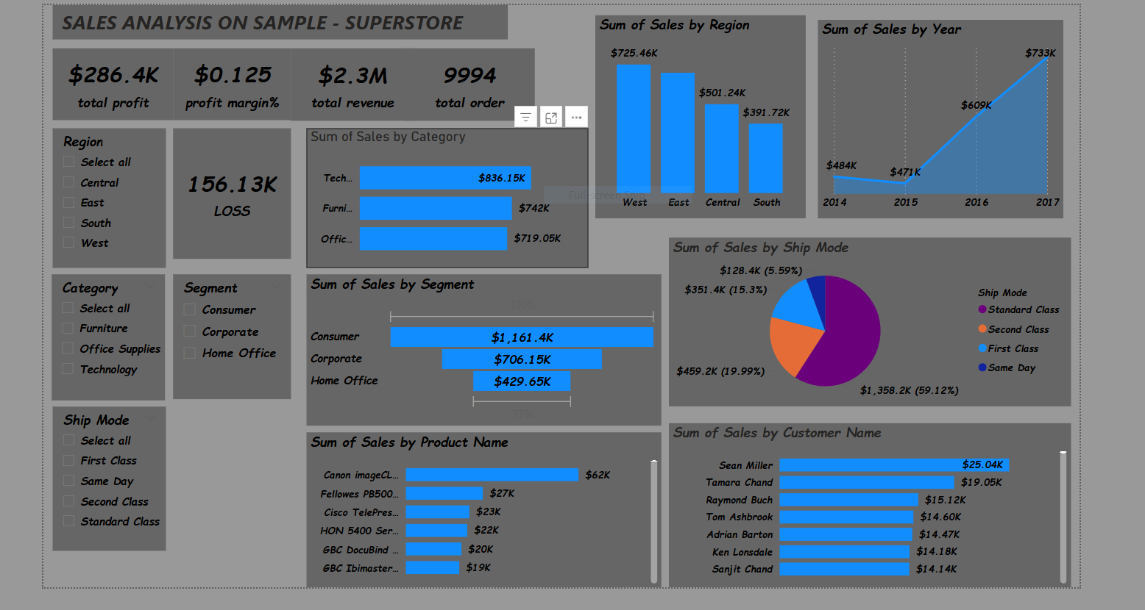
Key KPIs overall business health 2014-2017
total revenue $2.3m
total profit $286.4k
profit margin 12.5%
total orders 9994
total loss $156.13k INSIGHT; revenue is healthy at $2.3m but the loss of $156.13k has to be investigated

Slide 3
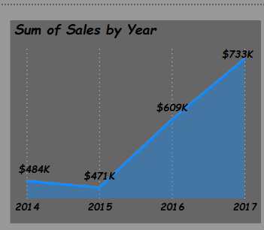
Sales trend over the years sum of sales by year
year 2014 with $484k sales
Year 2015 with $471k sales
Year 2016 with $609k sales
Year 2017 with $733k sales
INSIGHT; in the year 2015 was a -2.7% decrease in sales from the sales of 2014, from 2015 t0 2016 there was a 29.3% growth in sales and from 2016 to 2017 there was 20.4% increase in sales.
After the 2.7% dip sales in 2015, sales grew 55.6% by 2017.

Slide 4
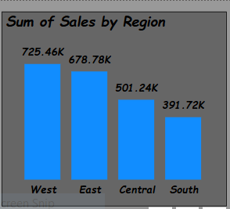
Regional performance sales by region
Sales according to the 4 regions in order of hierarchy
West: $725.46k (31.6% of total) top performing region
East: $678.78k (29.6%)
Central: $501.24k (21.8%)
South: $391.72k(17.0%) lowest performing region

Slide 5
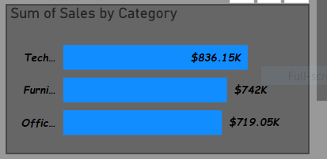
Product category analysis sales by category
There are a total of 3 different categories. All 3 categories are balanced, no category is really under performing. The tech category leads slightly
Technology: $836.15k
Furniture :$742k
Office supplies:$719.05k

Slide 6
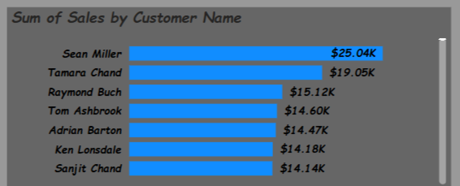
Top customers-relationship focus top 5 customers by sales
Sean Miller :$25.04k
Tamara Chand: $19.05k
Raymond Buch: $14.60k
Tom Ashbrook: $14.47k
Adrian Barton: $14.18k
Top 5 customers approximately $90k which is equivalent to 4% of total revenue.

Slide 7
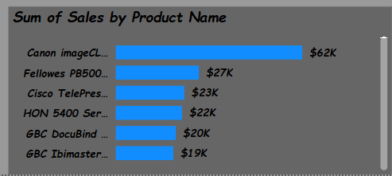
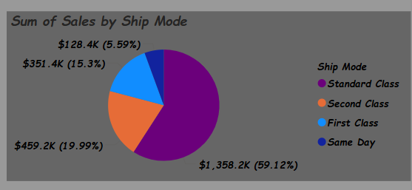
Sum of products by sales
There’s a big gap between the first product and the second product in term if sales .
The first product drives 36% of the top 6 product revenue at $62k as a total of sale made.
Standard class as a mode of shipping orders produced the highest sale so far. More than half (59.12%) sales used the standard ship mode i.e most customers prefer to use the standard shipping mode to get orders across to themselves.

Slide 9
Profitability and loss deep dive
We can grow profits withot fixing leaks that causes loss, certain questions needs to be addressed in order to grow profits. Questions like
Where are we losing money?
Where are those leaks that cause loss?
Where can we come to to reduce the loss and stop these leaks?
Likely drivers to investigate;
Discounts too high on furniture
Unprofitable products in south\central
High shipping cost for low value orders

Slide 10
Summary
Superstore is growing, but profit is being eaten by losses and regional imbalance
Growth opportunities
Geography\ regional; growth sales in the south region with targeted promos
product; upsell technology accessories to office supplies buyers
Operations; reduce loss by 50%
Launch vip program for top 20 customers.

